Slide 1
Unification in a Compartmentalized Culture¹
Mat Soukup, Ph.D.
Deputy Division Director, Biometrics 7
FDA/CDER/OTS/OB
Mat.Soukup@fda.hhs.gov
¹Focus is on late phase clinical research (i.e. Phase 2 – 4 studies/trials
Disclaimer: The views expressed in this presentation are those the presenter and must not be taken to represent policy or guidance on behalf of the Food and Drug Administration.

Slide 2
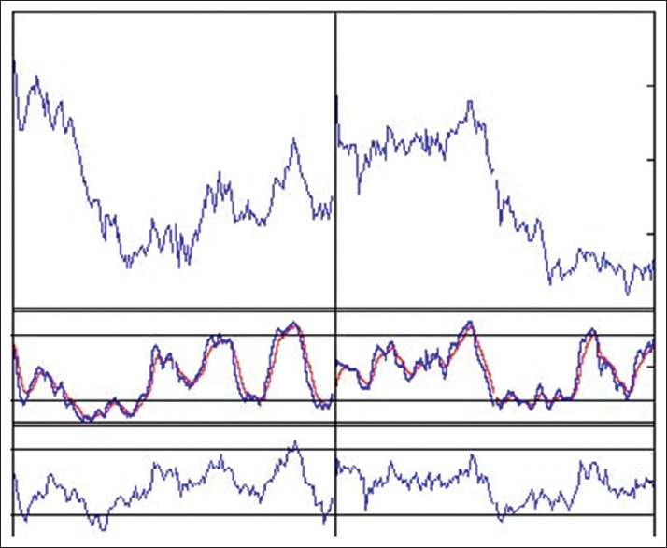

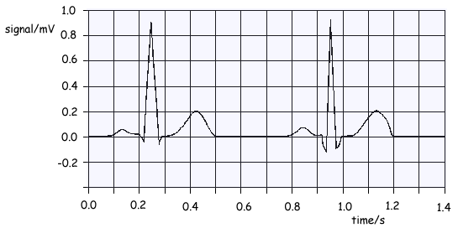
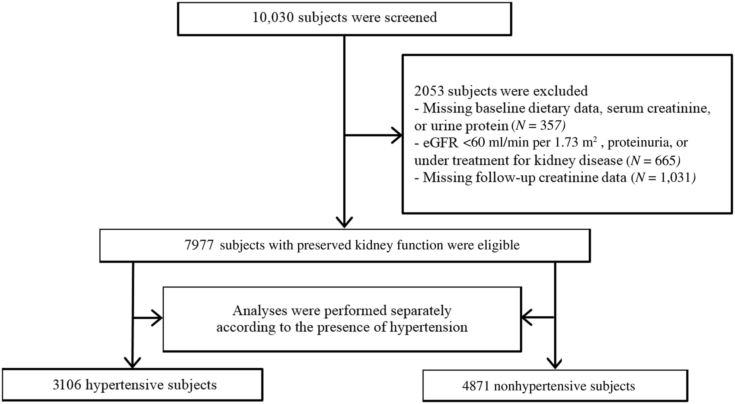
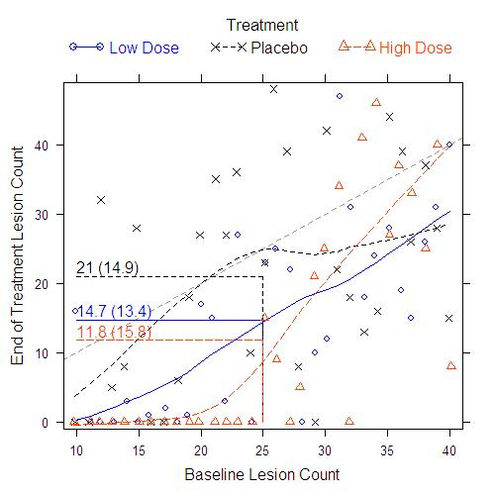
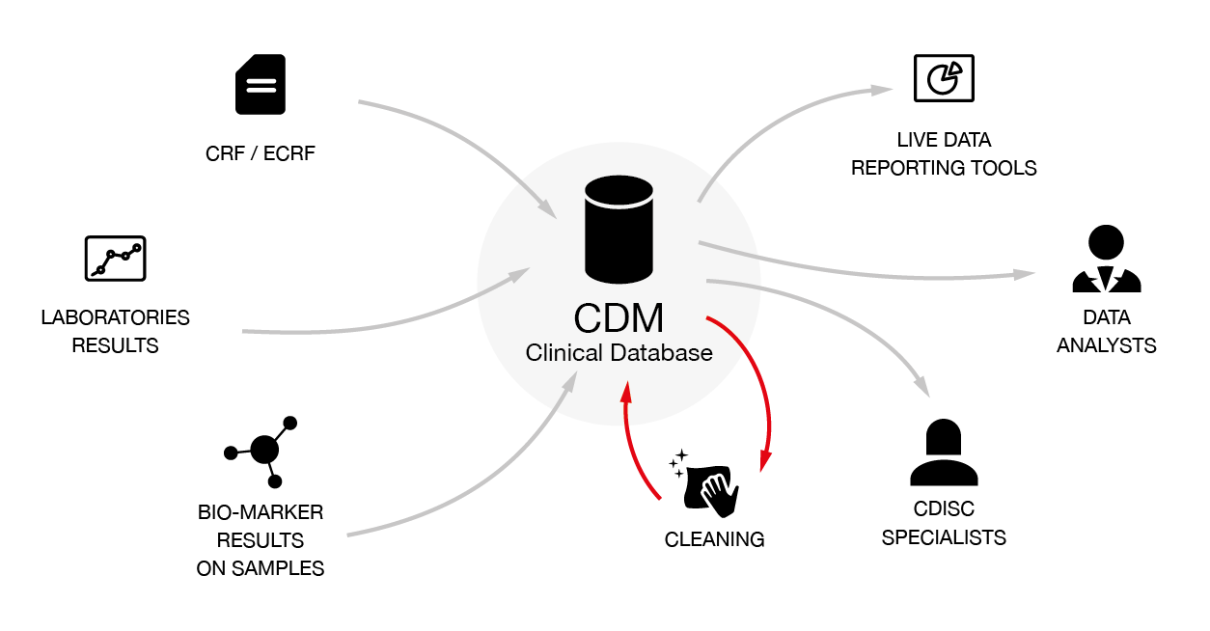
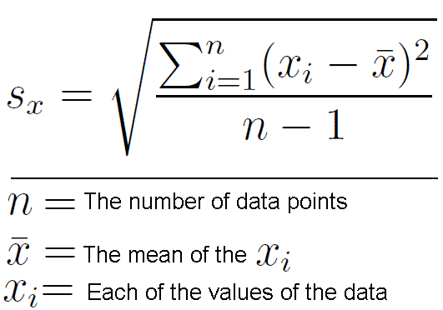
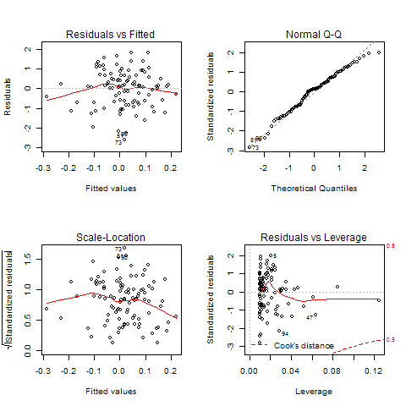
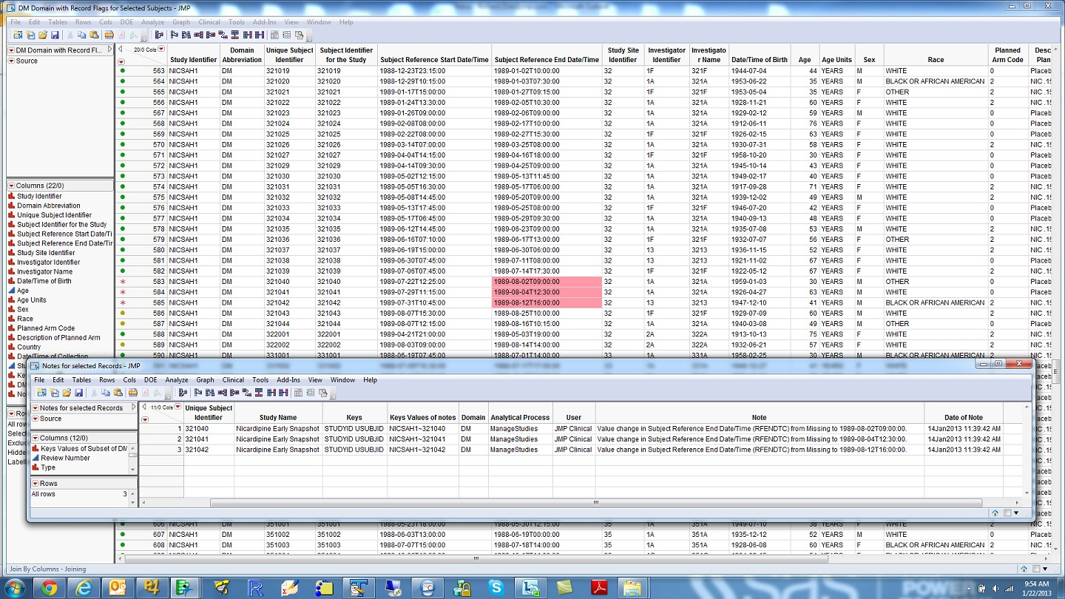
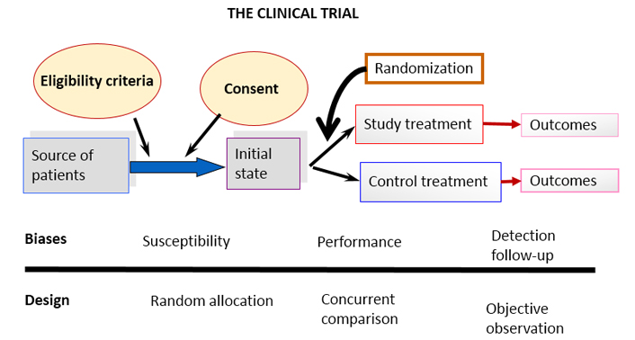
Compartmentalized Culture
Across disciplines
Across organizations
Across therapeutic areas
Even….
Within disciplines
Within organizations
Within therapeutic area

Slide 3
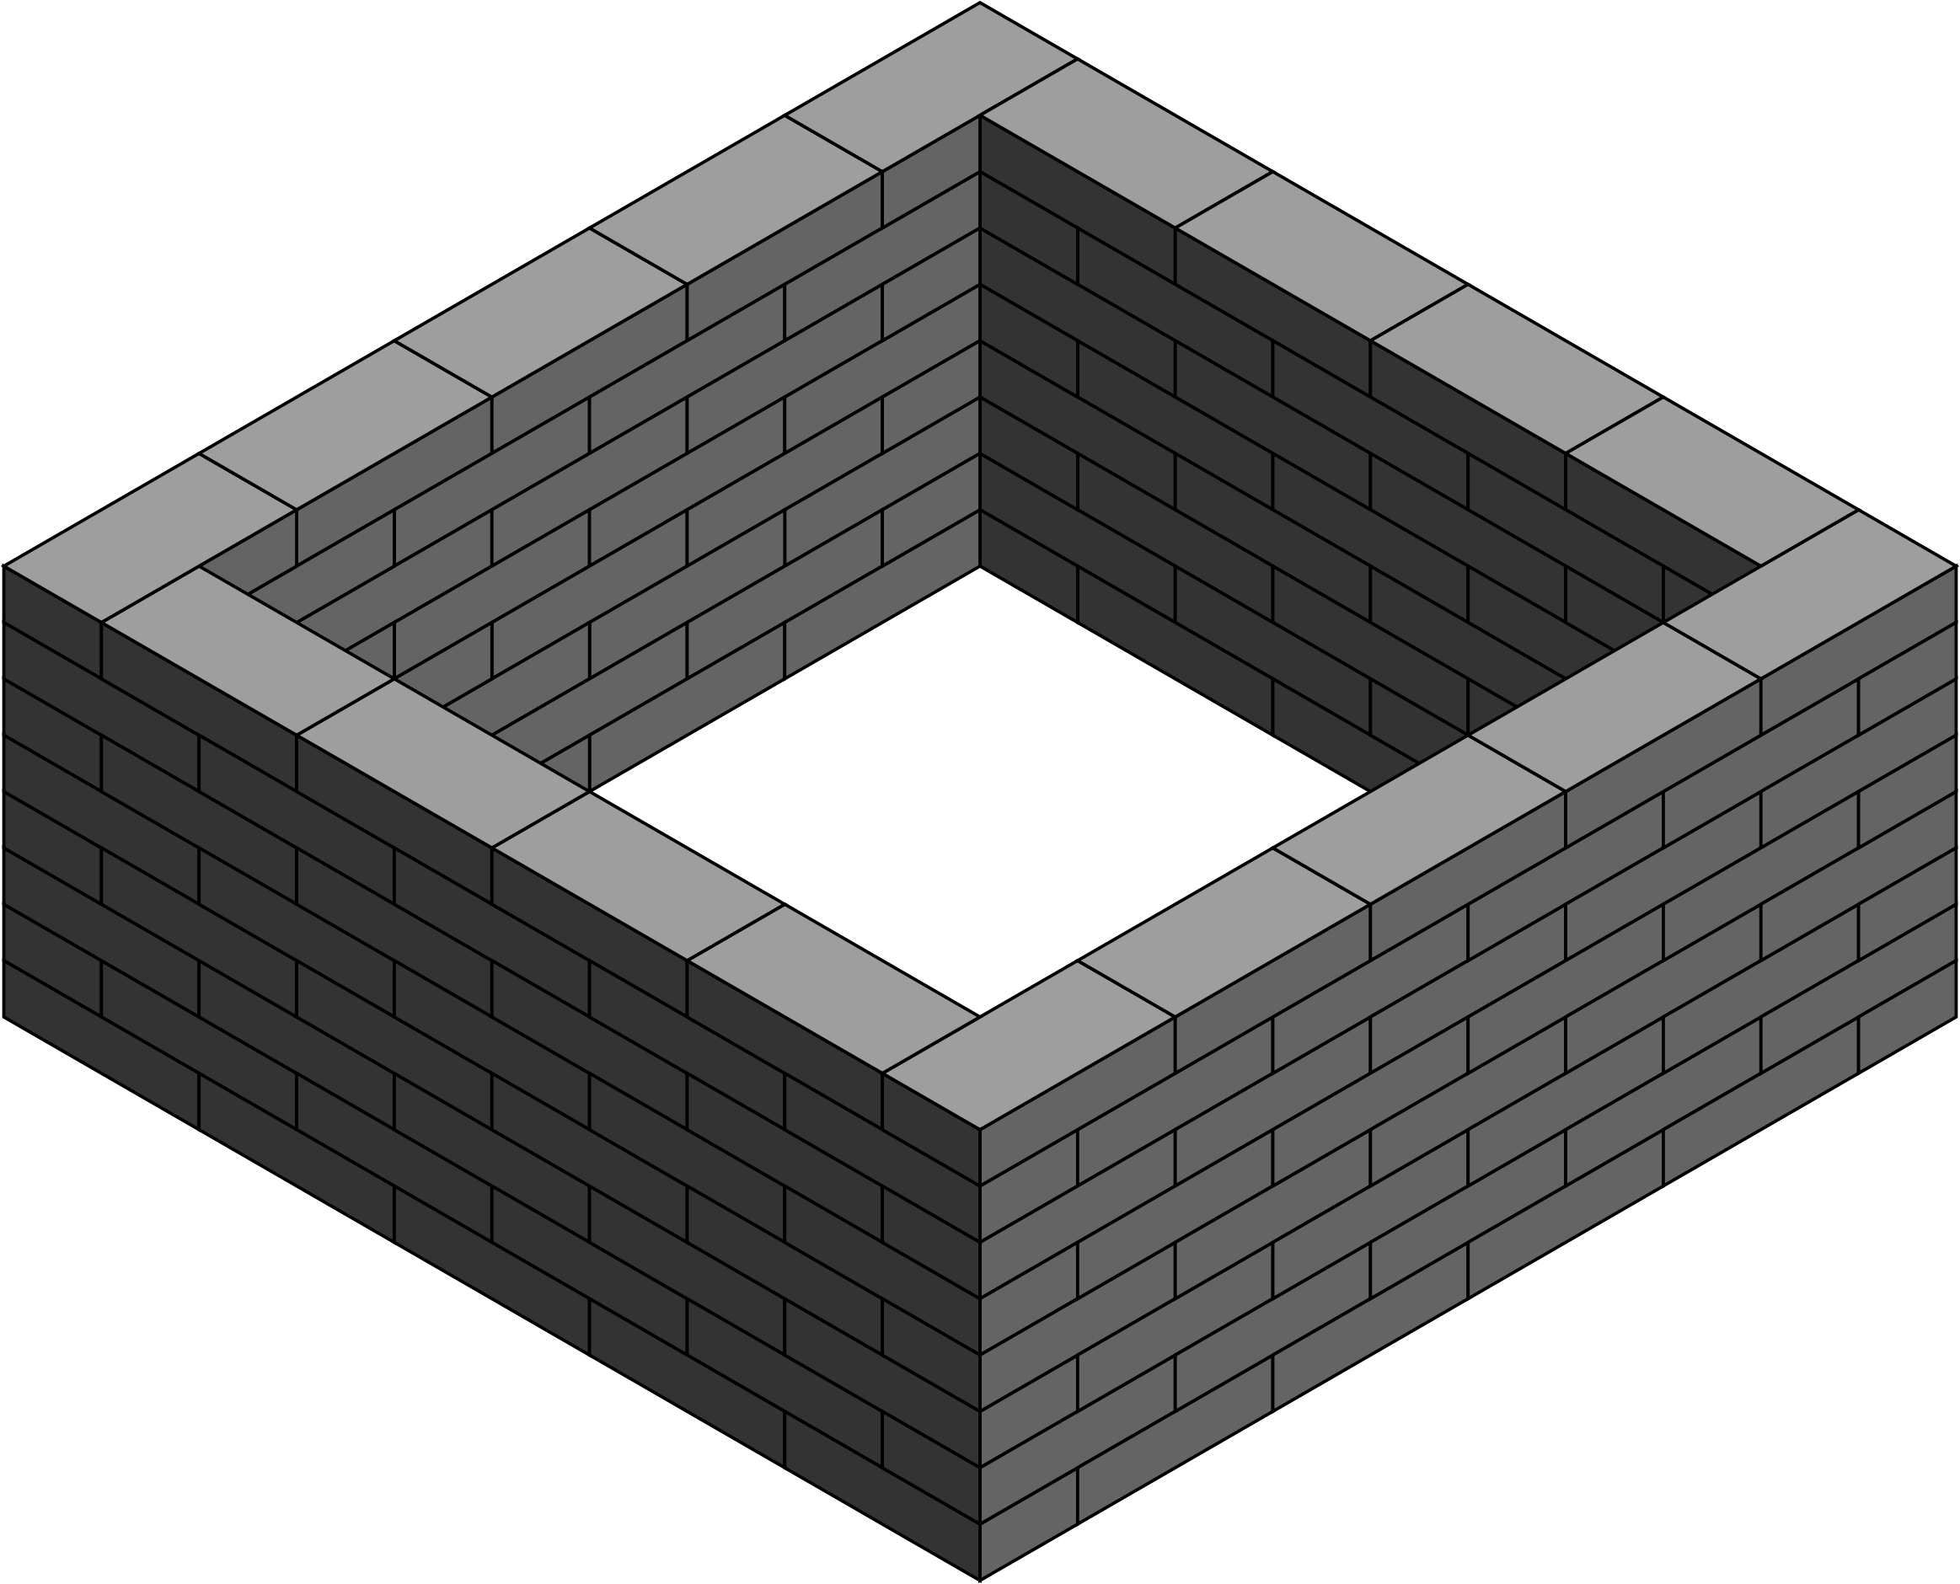

Efficiency
Pliability
Evolvement
Ramifications
Novelty
Innovation
Ingenuity
Creativity
Modernization

Slide 4
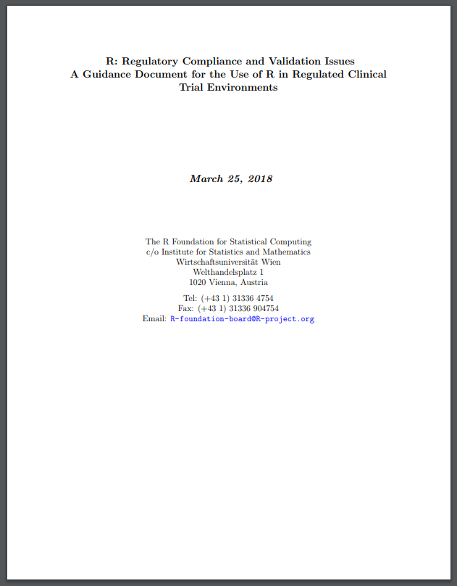




Why Compartmentalized?
Everyone uses their own data structures
Software licensure is an issue
R cannot be used in controlled environment
FDA does not accept analyses based on R
FDA Statistical Software Clarifying Statement: “FDA does not require use of any specific software for statistical analyses, and statistical software is not explicitly discussed in Title 21 of the Code of Federal Regulations [e.g., in 21CFR part 11]. However, the software package(s) used for statistical analyses should be fully documented in the submission, including version and build identification.
…..”
OpenBUGS
May 6, 2015
FDA Statement: https://www.fda.gov/downloads/forindustry/datastandards/studydatastandards/ucm587506.pdf
R Compliance Doc: https://www.r-project.org/doc/R-FDA.pdf

Slide 5

So why are we still compartmentalized?
It’s been the culture,
and culture is hard to change.

Slide 6
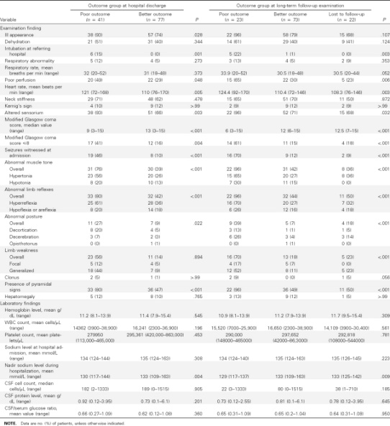
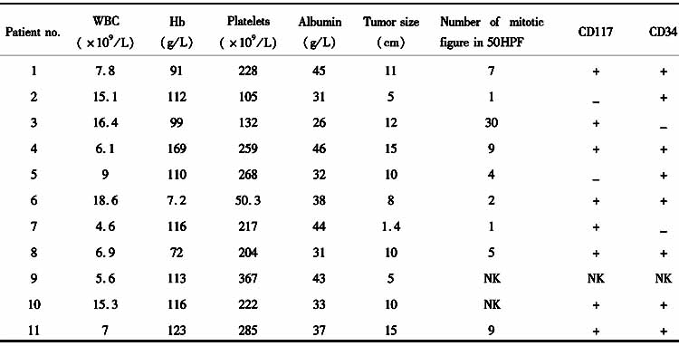
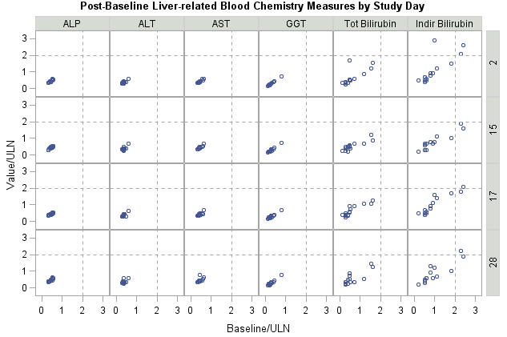
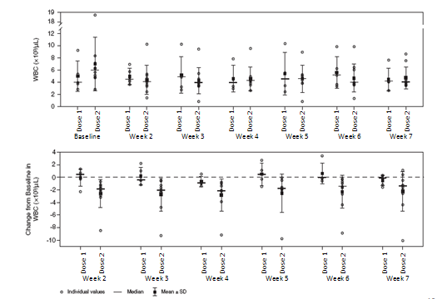
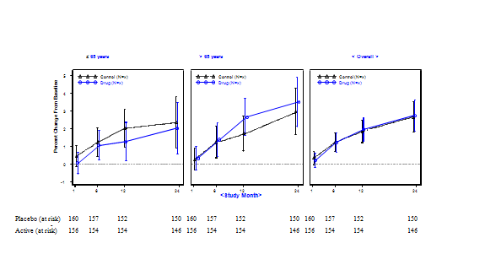
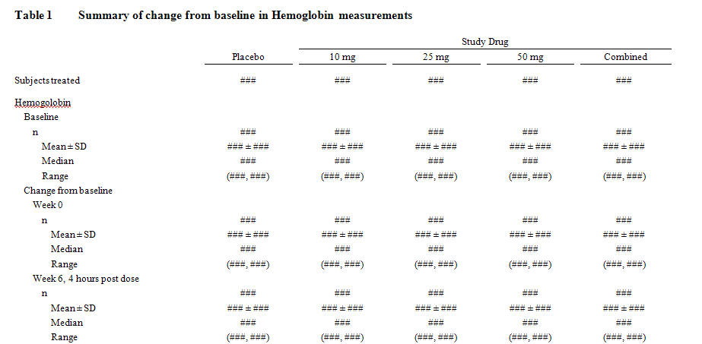
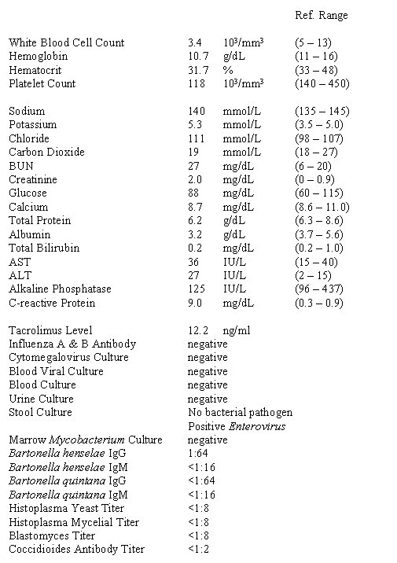
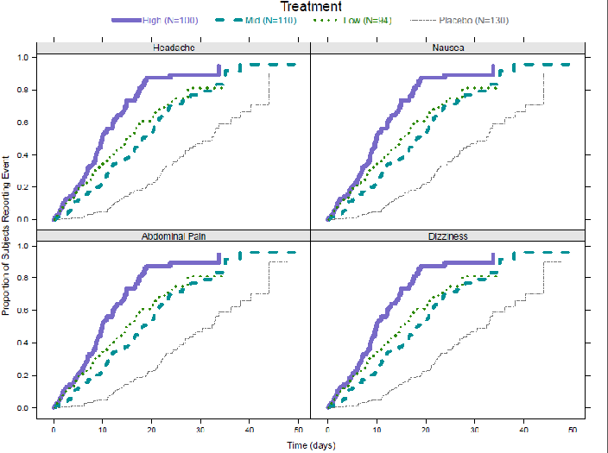
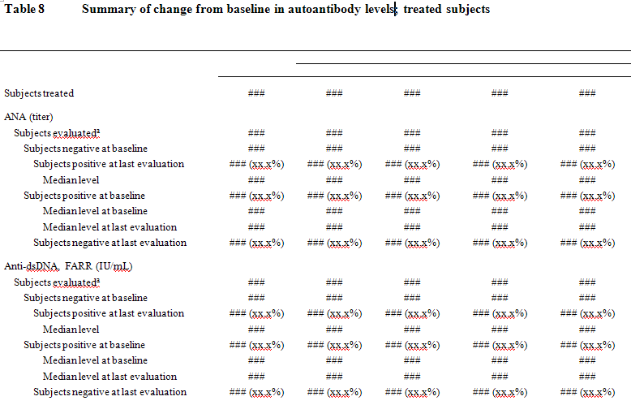
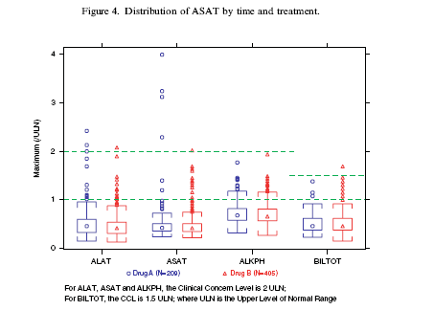
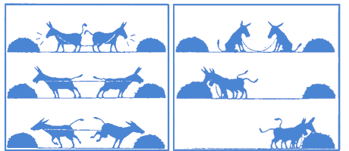
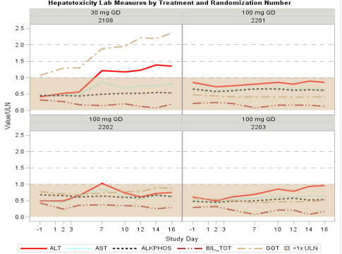
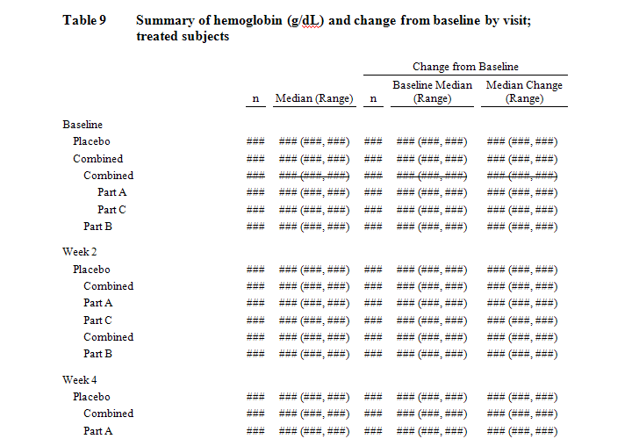
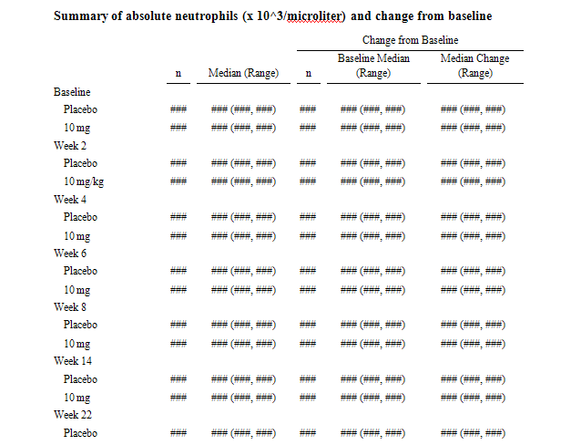
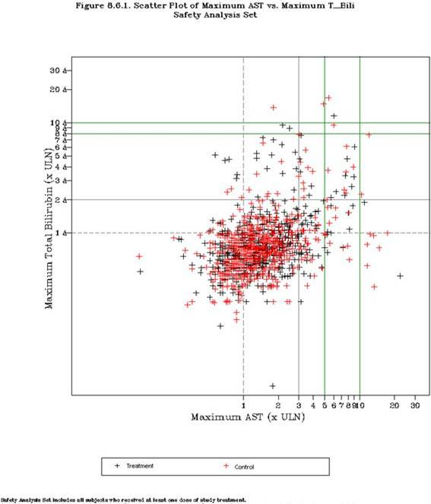
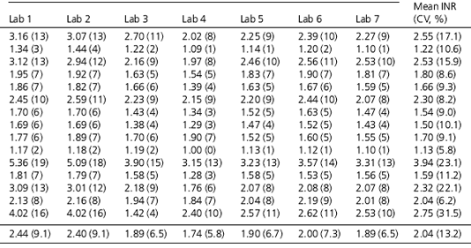
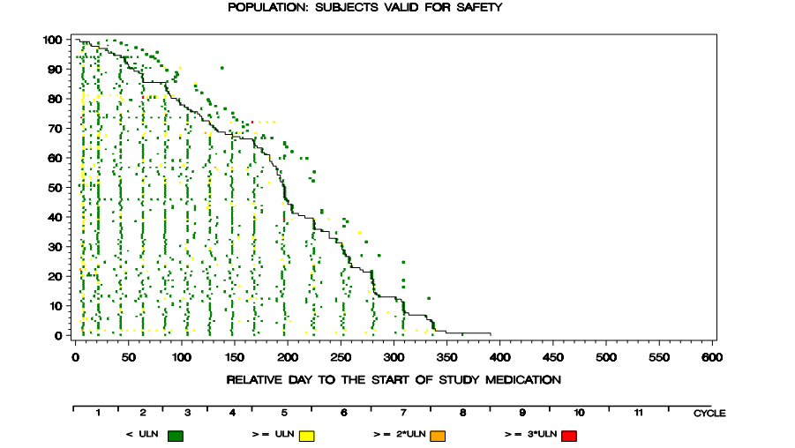
Changing the Culture
FDA/Industry/Academia Safety Graphics Working Group
Move from This!
To This!
The old way
The future way
Amit, hieberger, Lane ‘Graphical approaches to the analysis of safety data from clinical trials’ 2007
https://www.ctspedia.org/do/view/CTSpedia/StatGraphHome

Slide 7
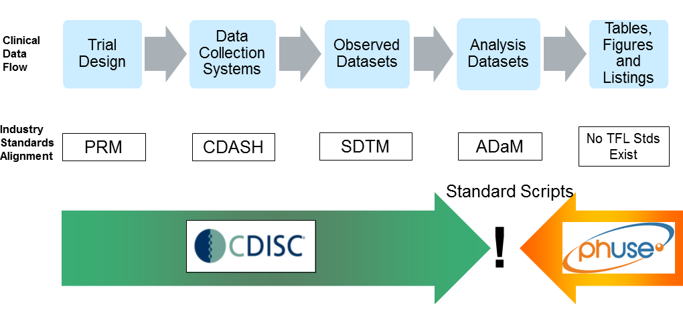
PhUSE Standard Analyses and Code Sharing Working Group
Vision: Leverage crowd-sourcing to improve the content and implementation of analyses for medical research, leading to better data interpretations and increased efficiency in the clinical drug development and review processes.
Changing the Culture
The old way
The future way
https://www.phusewiki.org/wiki/index.php?title=Standard_Analyses_%26_Code_Sharing

Slide 8
ASA Biopharm Safety Scientific Working Group
Interactive Safety Graphics Taskforce
Co-leaders: Susan Duke, Jim Buchanan, Jeremy Wildfire
Changing the Culture
Brings clinicians and statisticians together to develop solutions for evaluating safety
Clinicians identify the clinical workflow for specific safety areas
Statisticians provide the implementation through visualizations
Relies upon R Shiny/Java script technologies
Version 1.0 to assess hepatotoxicity is scheduled for release in late 2018/early 2019
The old way
The future way
https://asa-dia-interactivesafetygraphics.github.io/safety-eDISH

Slide 9



Office of Biostatistics in CDER/FDA
Modernization of Pharmaceutical Product Review
From This!
Technology and science advance, difficult for the statistical reviewer to be adept at everything
Requires technical expertise to support statistical science and vice versa
Recently started hiring GS 1530 statisticians
GS 1530 statisticians provide support to review divisions in various ways (e.g. research, program management, analytic development, knowledge management, etc.)
Changing the Culture
The old way
To This!
The future way

Slide 10

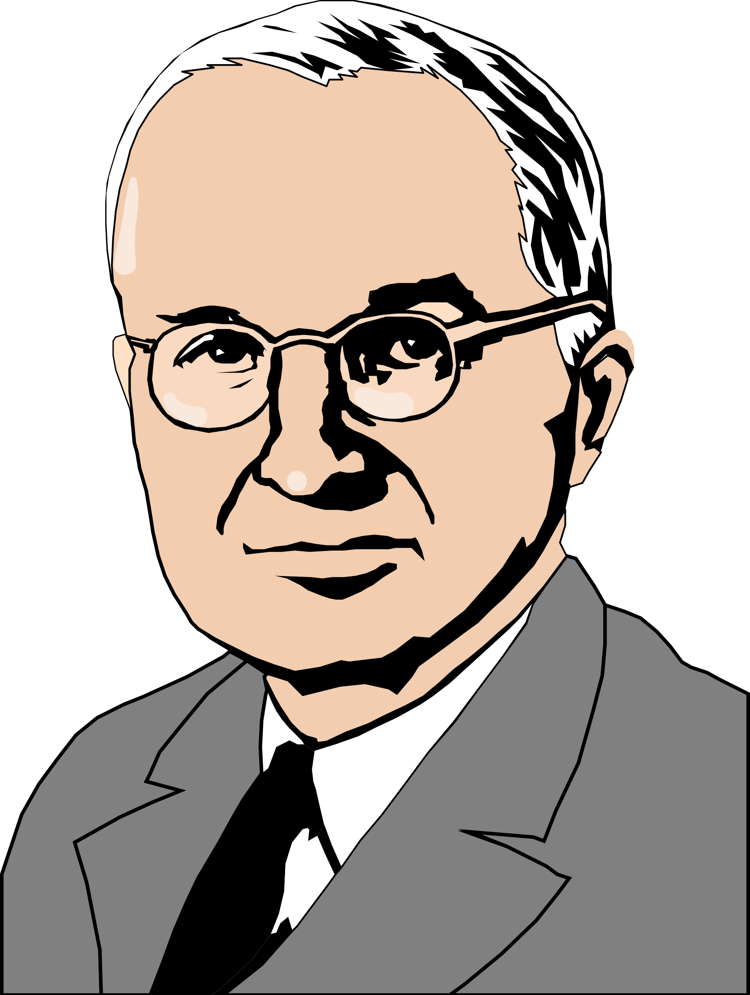
There are no constraints on the human mind, no walls around the human spirit, no barriers to our progress except those we ourselves erect. --Ronald Reagan
Men make history and not the other way around…. Progress occurs when courageous, skillful leaders seize the opportunity to change things for the better. --Harry S. Truman

